Slide 1
for Compliance, Safety, Prevention

Slide 2
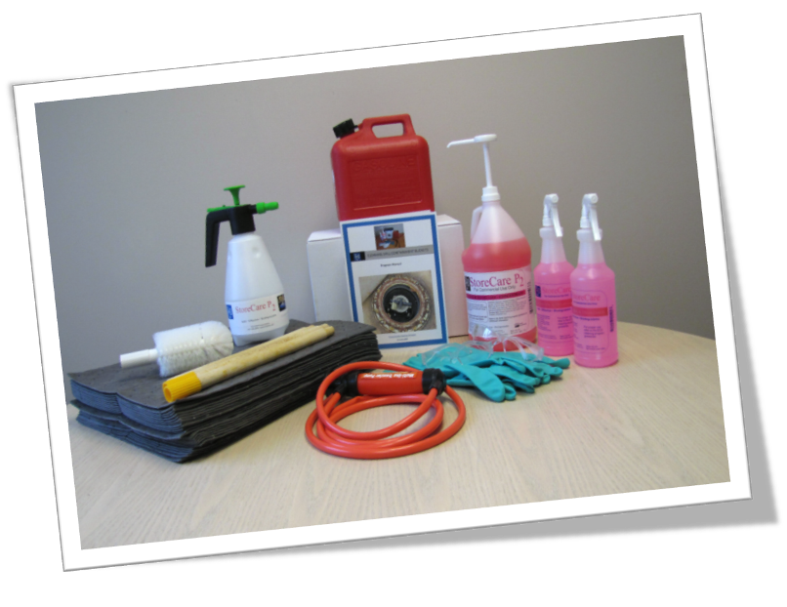
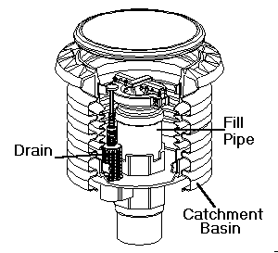
WHY: Standardize the Procedure

Slide 3
WHY: Daily
Spill Bucket Regulations -1301:7-9-06
(OH*)
(c) Owners and/or operators shall visually inspect all spill prevention equipment after each delivery and shall promptly remove and properly dispose of any water, regulated substances and/or debris from the spill prevention equipment;
* Regulation mirrors various state and federal requirements

Slide 4
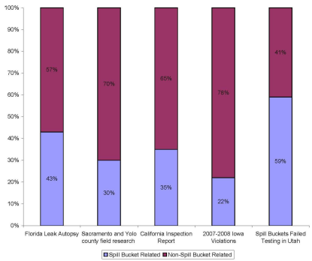
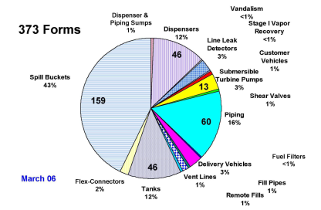
WHY: Daily
Percentage of UST System Failures Attributed to Spill Buckets
Spill Prevention

Slide 5
WHY: Safety
Exposure from Spill Bucket Cleaning
• Content of Reformulated Gasoline
Substance Weight % In Liquid Weight % In Vapor
Benzene 1.0 0.3
Ethyl Benzene 1.6 NA
Toluene 8.0 NA
Xylene 2.4 NA
NA - Information not available at this time
CAPCOA Air Toxics "Hot Spots" Program
Gasoline Service Station Industry wide Risk Assessment Guidelines

Slide 6
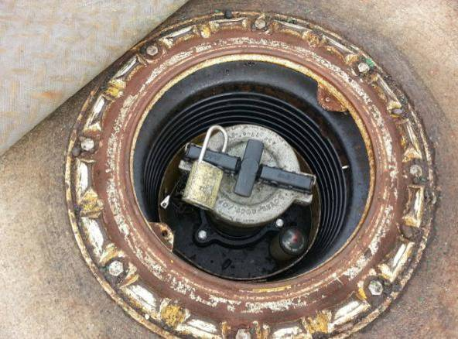
Daily Spill Bucket Cleaning

Slide 7
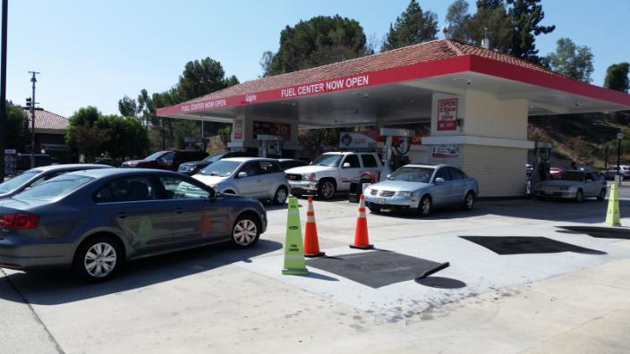
Spill Buckets are typically in high traffic areas.
Personal Safety is paramount

Slide 8
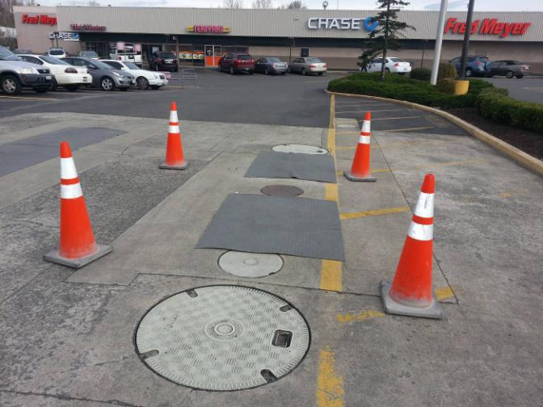
Cone the area you will be working in

Slide 9
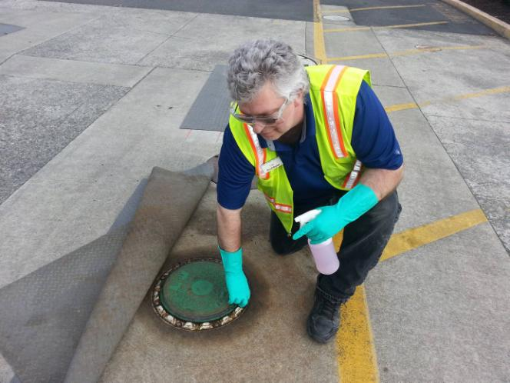
Use caution when opening the spill bucket

Slide 10
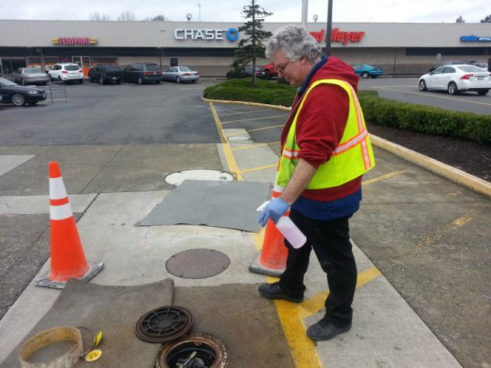
Spray the P2 cleaning chemistry over the opening
to suppress any possible vapors

Slide 11
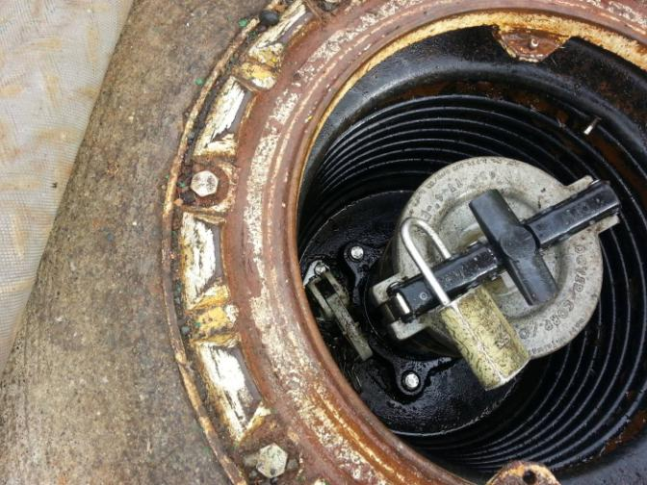
If only fuel present, pull tab to release into tank (if applicable)
Or remove as directed

Slide 12
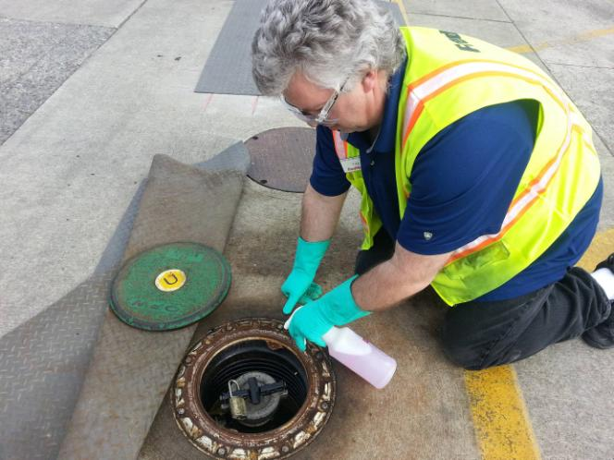
If only water less than 2 inches Spray P2

Slide 13
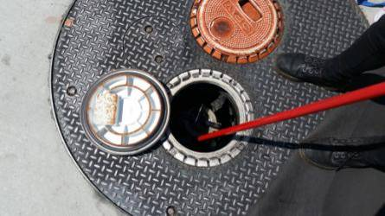
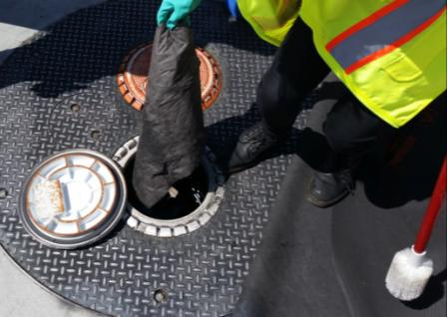
Mix with brush and pick up with wipers
make sure there are no dripping pads

Slide 14
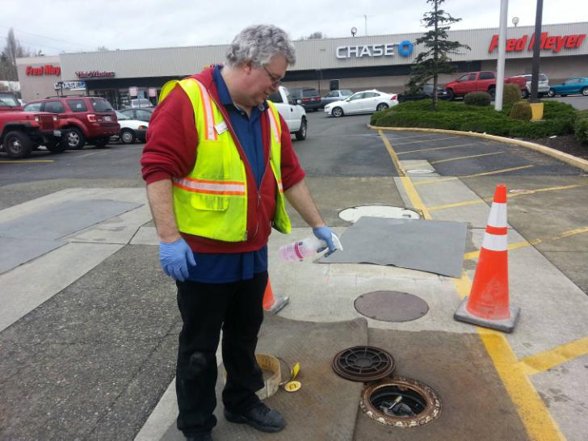
To Clean Spill Bucket; Spray P2 onto sidewalls

Slide 15
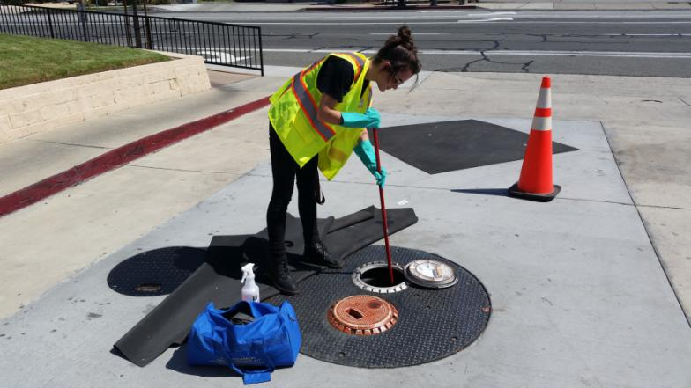
Using the brush, scrub the sidewalls and entire bucket

Slide 16
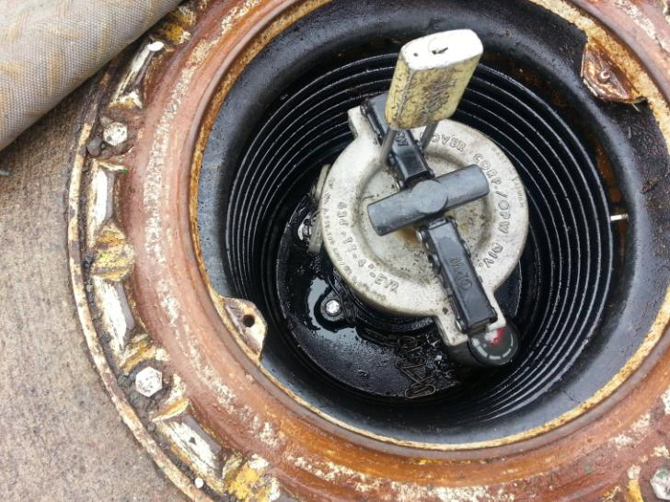

Slide 17
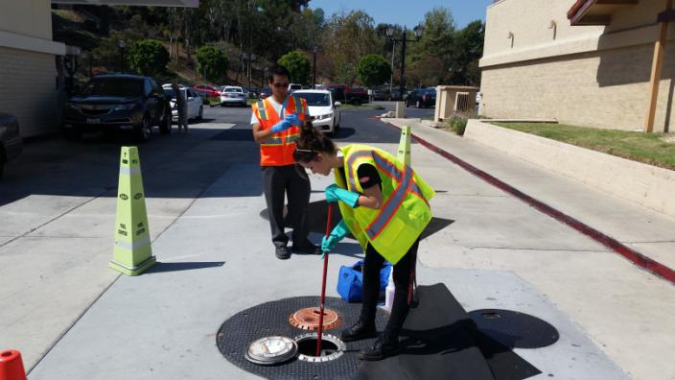
Wrap wiper around brush and wipe inside clean

Slide 18
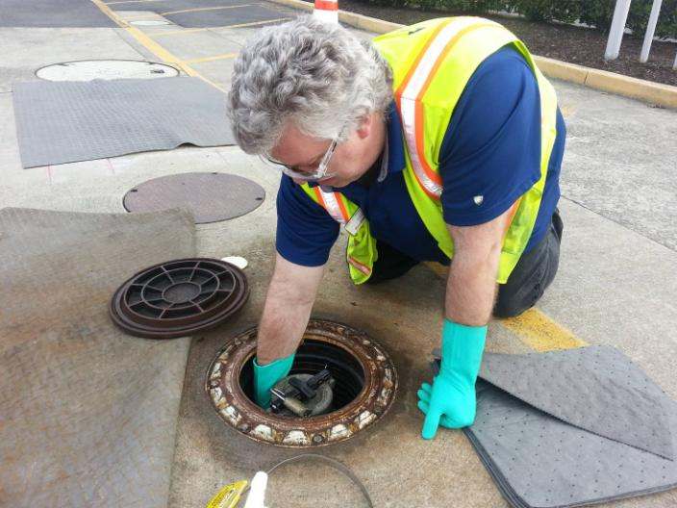
Make sure you wipe areas the brush/wiper method might miss.

Slide 19
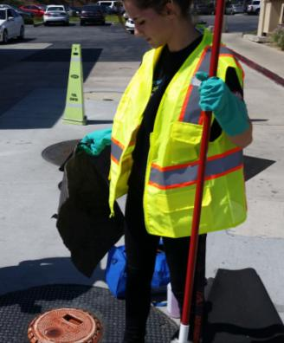
Dispose as Instructed.
*Petroleum waste is a presumptive hazardous waste and the users/generators are responsible for proper waste characterization and disposal. Regulations establish that prior knowledge of the waste and the treatment process in which it was generated can be applied in determining a waste's classification. The FM 186 program is an immediate response spill treatment procedure that can be applied as part of prior knowledge in which the waste was generated. Federal and state regulations state that generators shall determine their waste classification and dispose of it correctly. Nothing herein is to be taken as approvals that all spill materials would be rendered non-hazardous.

Slide 20
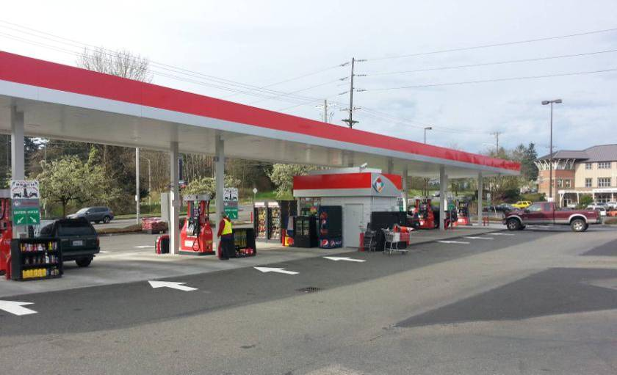
Thinking Safety Thinking Environmentally

